Slide 1
Manufacturing quality prediction
Presented by Ananya Jha, Devraj Sharma, Habibulla, Ayush Babu & Muddassir Ahmed

Slide 2
Problem statement
02 / 15
In modern manufacturing, undetected defects on the shop floor lead to significant material waste, costly rework, and supply chain delays. The objective of this project is to build an automated, production-ready DataOps and MLOps pipeline that predicts product quality in real time. Using the manufacturing_defects.csv dataset, the system continuously analyzes 16 numerical sensor and process features to predict the DefectStatus of a manufactured unit. By automating the data ingestion, model training, and real-time API serving, this architecture allows quality control teams to proactively identify and isolate defective components before they advance further down the assembly line.

Slide 3
Dataset Description
03 / 15
The dataset provides insights into factors influencing defect rates in a manufacturing environment. Each record represents various metrics crucial for predicting high or low defect occurrences in production processes.
It includes production volumes, supply chain quality, quality control assessments, maintenance schedules, inventory management details, workforce productivity metrics, energy consumption patterns, additive manufacturing specifics, and more.

Slide 4
Quote
04 / 15
ARCHITECTURE
DATA SOURCE → DATA INGESTION → DATA VALIDATION / QUALITY → TRANSFORMATION / FEATURE ENGINEERING → MODEL TRAINING → MLFLOW → MODEL VALIDATION → INFERENCE / DEPLOYMENT → MONITORING

Slide 5
Quote
05 / 15
Data Ingestion
Loading the CSV from the shared directory
Checking the shape of the data (rows, columns)
Quality Check: Looking for missing values
Preview the data
Python library used - Pandas

Slide 6
Quote
06 / 15
Feature Engineering
Separate features (X) and target (Y)
Split into training and testing sets (80% train, 20% test)
Scale the numerical features
Python library used – Scikit-learn (sklearn)

Slide 7
Quote
07 / 15
Model Training
Initialize and train the model
Make predictions on the test set
Evaluate the model
Python library used – Scikit-learn (sklearn)

Slide 8
Baseline Model Accuracy
95.52%

Slide 9
Quote
09 / 15
MLflow
Connect to the MLflow tracking server
Create or set the experiment
Start the tracking run
Python library used – Scikit-learn (sklearn) + mlflow

Slide 10
Quote
10 / 15
Model Validation
Connect to the Mlflow
Fetch the latest run
Validate & register
Python library used – mlflow

Slide 11
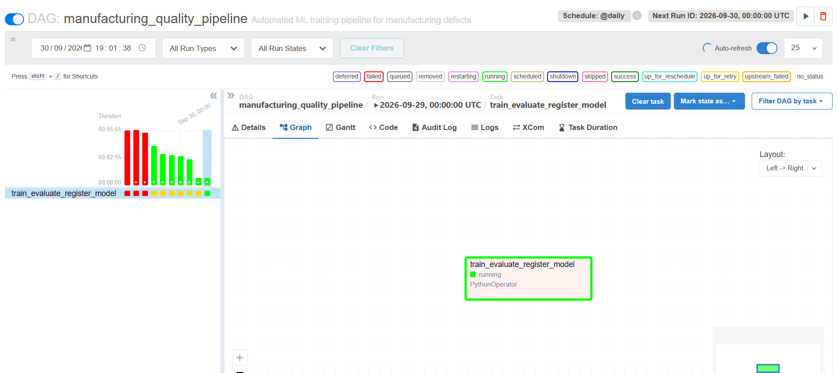
Quote
Airflow dag

Slide 12
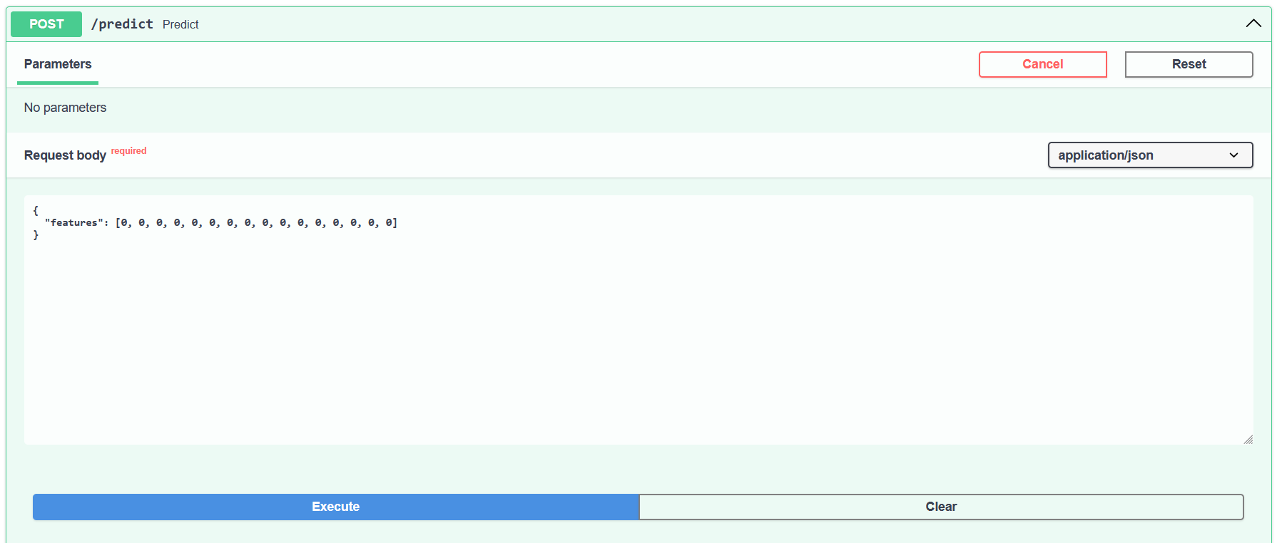
Quote
Inference / Deployment

Slide 13
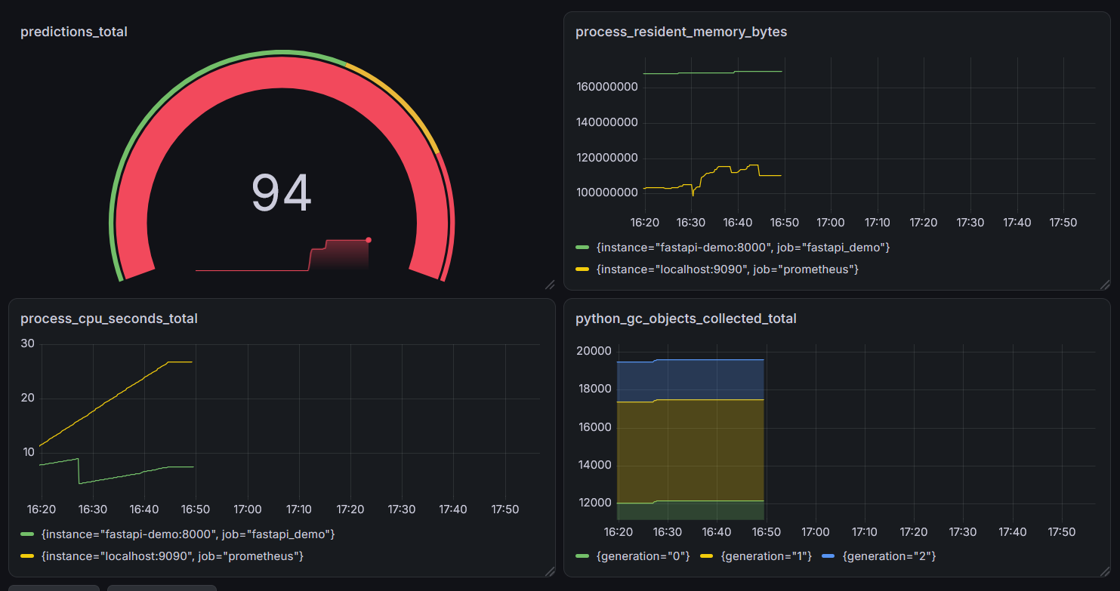
Quote
Grafana visualization

Slide 14
Quote
14 / 15
Individual contribution
Devraj Sharma – Data Ingestion
Mohammed Habibulla – Feature Engineering
Ayush Babu – Baseline Model Training
Muddassir Ahmed – Mlflow + Model Validation
Ananya Jha – Airflow + Grafana

Slide 15

Reference
https://www.kaggle.com/datasets/rabieelkharoua/predicting-manufacturing-defects-dataset
https://docs.python.org/3/library/index.html
https://www.guvi.in

